Slide 1
Constructing Quadratic Surface with Nine Points in GeoGebra
Tõnu Tõnso, Tallinn University, lecturer, tonu@tlu.ee
Rando Tõnso, University of Tartu, IT student, rt.peakonto@gmail.com

Slide 2
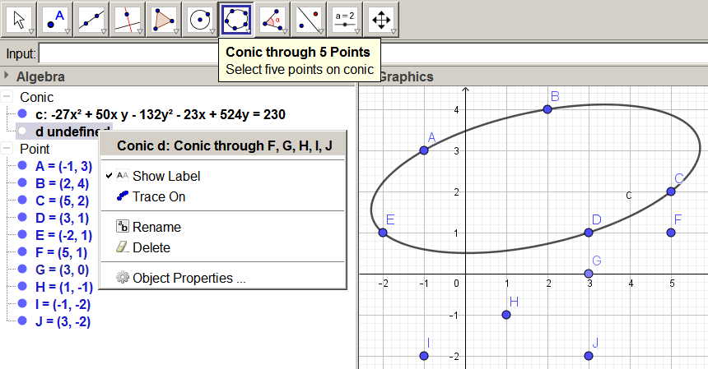
Tool for conic passing through 5 points:

Slide 3
Equation of conic passing through 5 points:
Conic section is a quadratic curve, which has general form
The coefficients in (1) cannot all be zero. If we know which coefficient is nonzero, then we can divide all coefficients by it and reduce the number of unknown coefficients to five.
Thus, five points (x₁; y₁), (x₂; y₂), (x₃; y₃), (x₄; y₄) and (x₅; y₅) are sufficient to uniquely determine a conic.
Substituing these points into conics equation, we get 5 equations:
Equation (1) and five equations (2) form a homogeneous system of six equations in six variables:

Slide 4
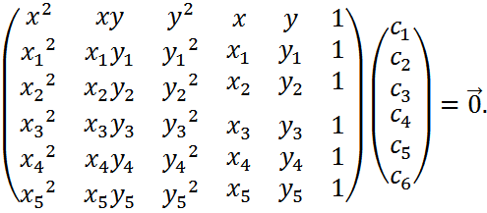
Equation of conic passing through 5 points:
Homogeneous system of six equations in six unknowns:
Since the solution vector C = (c₁, c₂, c₃, c₄, c₅, c₆) must be non-zero, the determinant of the coefficient matrix must be zero:

Slide 5
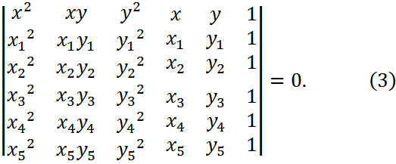
Equation of conic passing through 5 points:
This is equation for conic passing through 5 points.
Formula (3) is well-known and can be found in web encyclopedia MathWorld: http://mathworld.wolfram.com/ConicSection.html

Slide 6
Equation of quadratic surface passing through 9 points:
The general equation for a quadratic surface (also called quadric) is a quadratic equation in three variables involving ten coefficients:
The coefficients in (4) cannot all be zero. If we know which coefficient is nonzero, then we can divide all coefficients by it and reduce the number of unknown coefficients to nine.
Nine points (x₁; y₁), (x₂; y₂), (x₃; y₃), (x₄; y₄), (x₅; y₅), (x₆; y₆), (x₇; y₇), (x₈; y₈) and (x₉; y₉) are sufficient to uniquely determine a quadric.
Equation (4) and nine equtions (5) form a homogeneous system of ten equations in ten variables.

Slide 7
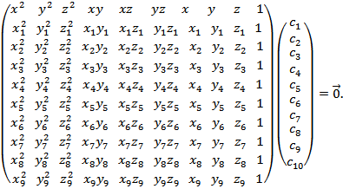
Equation of quadratic surface passing through 9 points :
Homogeneous system of ten equations in ten unknowns:
Since the solution vector C = (c₁, c₂, c₃, c₄, c₅, c₆, c₇, c₈, c₉, c₁₀) must be non-zero, the determinant of the coefficient matrix must be zero:

Slide 8
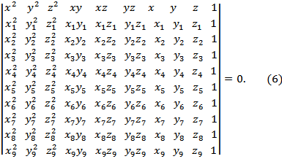
Equation of quadratic surface passing through 9 points:
This is equation for quadratic surface passing through 9 points.

Slide 9
Do arbitrary 9 points determine a quadric?
Do arbitrary 5 points on plane determine unique conic section?
Do arbitrary 9 points in space determine unique quadratic surface?
The answer to both questions is negative.
Assume there are 5 points on the plane such that arbitrary 4 points of them are not located on a straight line. Then there exists exactly one conic section, passing through all 5 points.
Assume there are 9 points in the space such that k points are not located on one plane while remaining 9-k points lie on the straight line. Then there exists exactly one second order surface, passing through all 9 points.
Both statements are given in estonian analytic geometry textbook [Lumiste, Ariva, Analüütiline Geomeetria, p 397-398], first of them is also proved there.

Slide 10
Testing possibilities and limits of GeoGebra
The 10th order determinant is a sum of up to 10! = 3628800 terms, each term being a product of nine numbers and one monomial from the first row.
Computing the 10th order determinant, simplifying the obtained expression and creating a 3D image of the 2nd order surface are usually complicated tasks.
Some computer algebra systems can do these things. Our interest was to examine if GeoGebra can do it. The answer is yes; however, certain problems appeared as well.

Slide 11
Our demonstration: https://www.geogebra.org/m/ehd8ff4q
Our demonstration + examples: https://www.geogebra.org/m/bb56r6hr
A folder containing all materials: https://github.com/rt-tondilt/Constructing-Quadratic-Surface-with-Nine-Points-in-GeoGebra

